Slide 1
User-Customized Restaurant Recommendation using NLP on OUR Customized Yelp Dataset
CSE6240: Web search and Data Mining
Somdut Roy
Vitaly Marin
Devanshee Shah
Georgia Institute of Technology
version 2.0

Slide 2
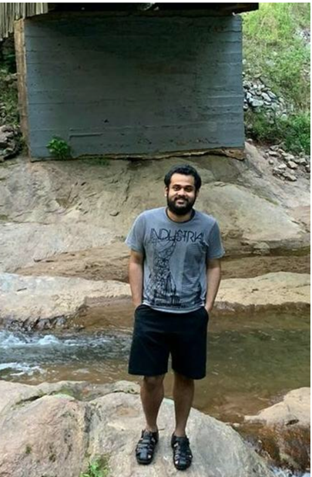
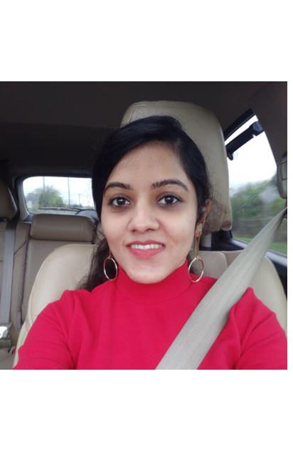
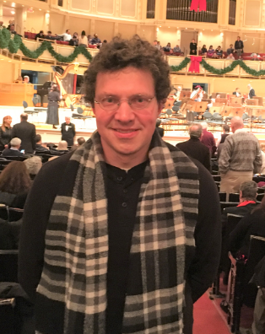
Our Team: Somdut Roy Vitaly Marin Devanshee Shah
Somdut Roy
Vitaly V. Marin
Devanshee Shah

Slide 3
Motivation/Introduction
Problem Description: You want to get a recommender system to provide a feedback where best to eat (at which restaurant) that you not been before provided your favorite restaurant provided only and restaurant user review/ratings. This presents a challenging problem.
Problem Importance: user recommender systems exist; however those have not been applied to our customized restaurant dataset with user ratings and <todo add here more>

Slide 4
Methodology: Baseline Approaches/Algorithms
What are baseline Approaches ?
Baseline Approach #1: SVM on vector data
Baseline Approach #2: Logistic Regression on vector data
Description of how each baseline approach work (baseline 1) (todo: add here)
Description of how each baseline approach work (baseline 2) (todo: add here)

Slide 5
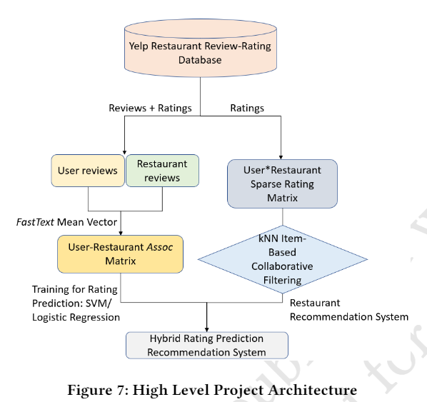
Our Approach/Algorithms Description
Our approach combines user restaurant ratings prediction based on Linear SVM (Baseline 1), Logistic Regression (Baseline 2) and item based collaborative filtering technique to create a hybrid ratings that can be used to sort the relevant restaurants for a specific user that user given only user’s preference for specific restaurant.
Our model is summarized in the diagram →

Slide 6
Our Approach/Algorithms Novelty
The Novelty of our approach is to create the hybrid ratings by combining rating prediction for restaurants and Item based collaborative filtering to restaurant dataset.
<todo add more details here.>

Slide 7
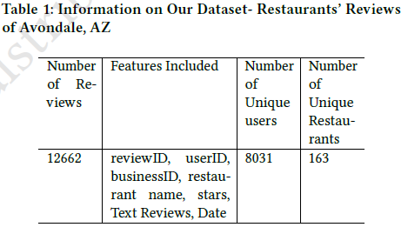
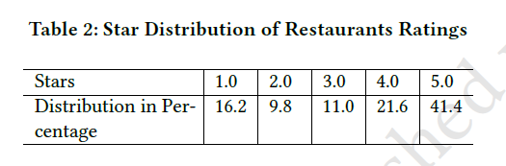
Our Dataset: customized Yelp Dataset. Finalized
Description of dataset and its useful features:
The Data was constructed using Yelp dataset

Slide 8
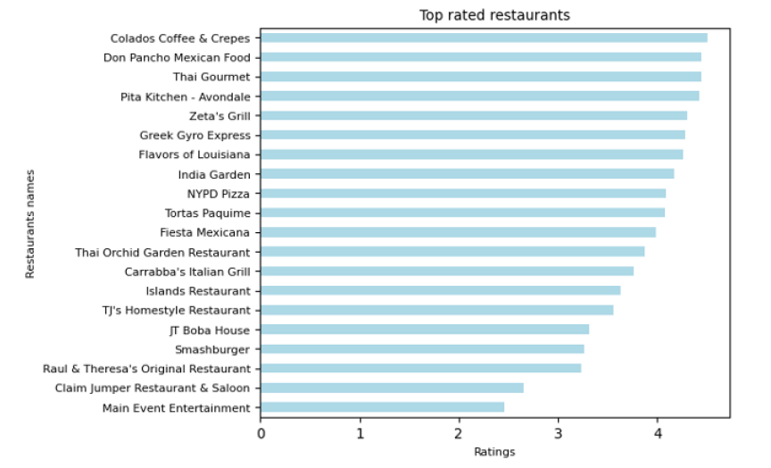
Our Dataset: customized Yelp Dataset. Finalized Cont. Features/Details

Slide 9
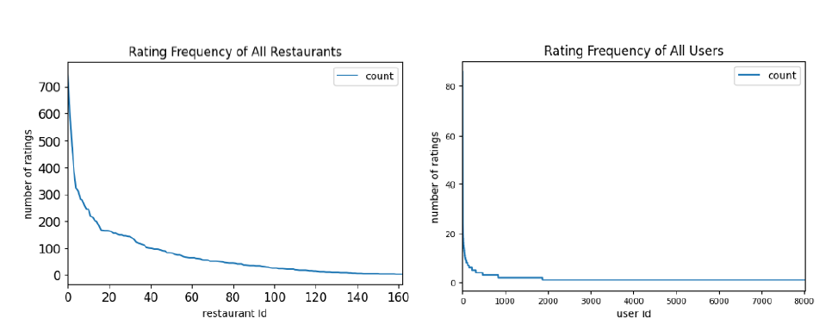
Our Dataset: Rating Frequency of Restaurants’ and User Frequency of all users

Slide 10
Experiments and Evaluations
Description of the experimentation setup .
(todo: add more here)
Description of evaluation criteria for the experiment: (RMSE ?)
(todo add more here)

Slide 11
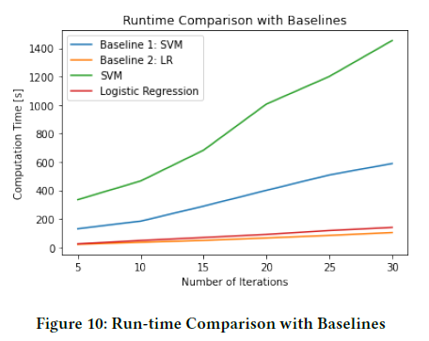
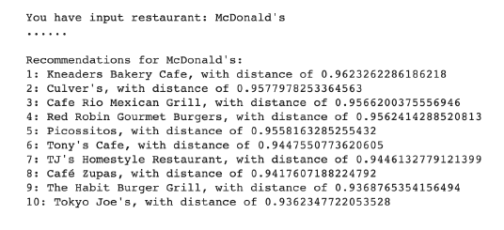
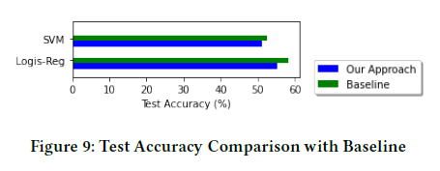
Our Results
Tables with results and graphics.

Slide 12
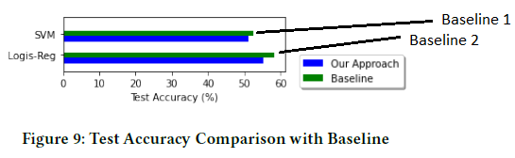
Our Results and Comparison to Baseline Results.
TODO: Add Metric used here.

Slide 13
Our Future Work
The future direction of our work:
Ex: To publish this work based benched marked on the dataset that researches use today.

Slide 14
Conclusion
Summary of effort. Add summary table here of results.

Slide 15
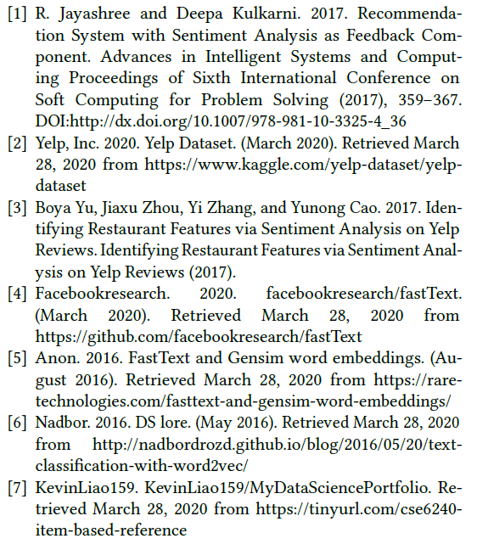
References:

Slide 16
DELETE WHEN DONE: Other criteria for grading
Aesthetics
5%: Was the layout nice (not too crowded)?
5%: Were the tables and figures understandable?
5%: Were the tables and figures appealing?
5%: Was the deliverable grammatically sound?
Presentation
5%: Did the presenter stick to the time limit? 6 minutes
5%: Did the presenter speak fluently and clearly?

Slide 17
DELETE WHEN DONE: Other criteria for grading
More about the rubric for presentation
https://docs.google.com/spreadsheets/d/1zKgWYXQG6DHmovZ_mNOUfoJUXPzwEDopr1TOiOZDrOA/edit#gid=0
More about presentation
https://docs.google.com/document/d/e/2PACX-1vTkhuGCW3z8imeDa7wpK-DcljxoXJttQ285D8p4c7-6jh47VEh1lBQH9B9Wpv6op2V_n8WegE9hSWhv/pub

